Slide 1
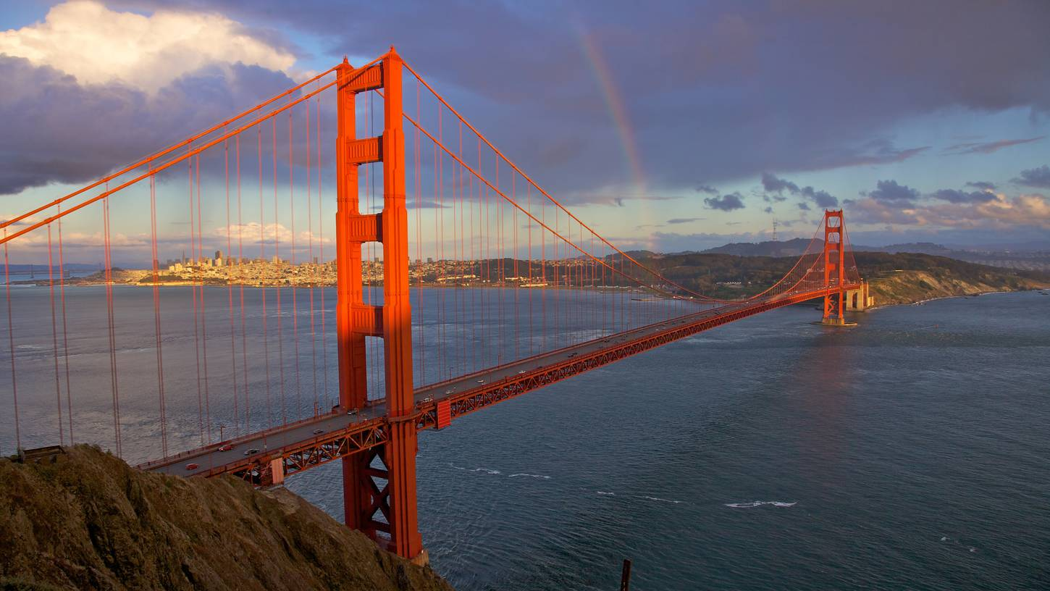
San Francisco Traffic - Air Quality Modeling and Health Risk Assessment
Shweta Mehta
February 17, 2016

Slide 2
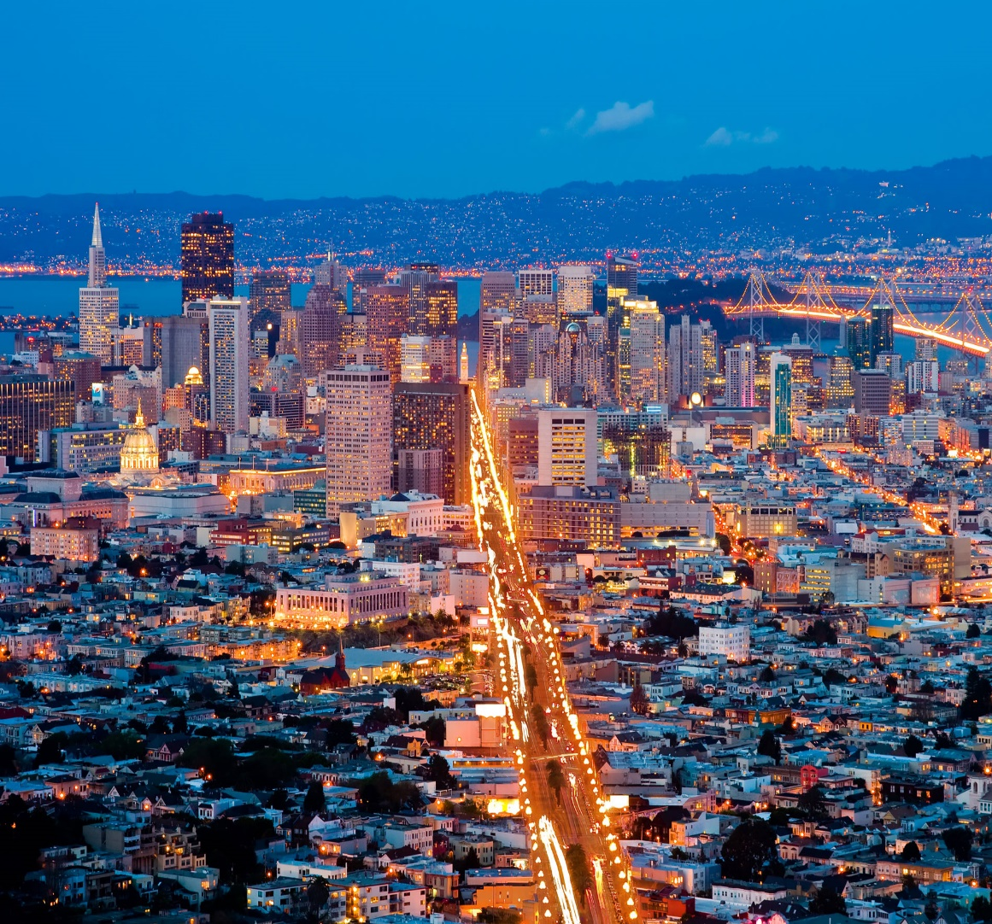
Outline
Project Motivation
Background
Methodology and Assumptions
Technical Tools
Results
Uncertainty/ Future Refinement
Challenges
Conclusions

Slide 3
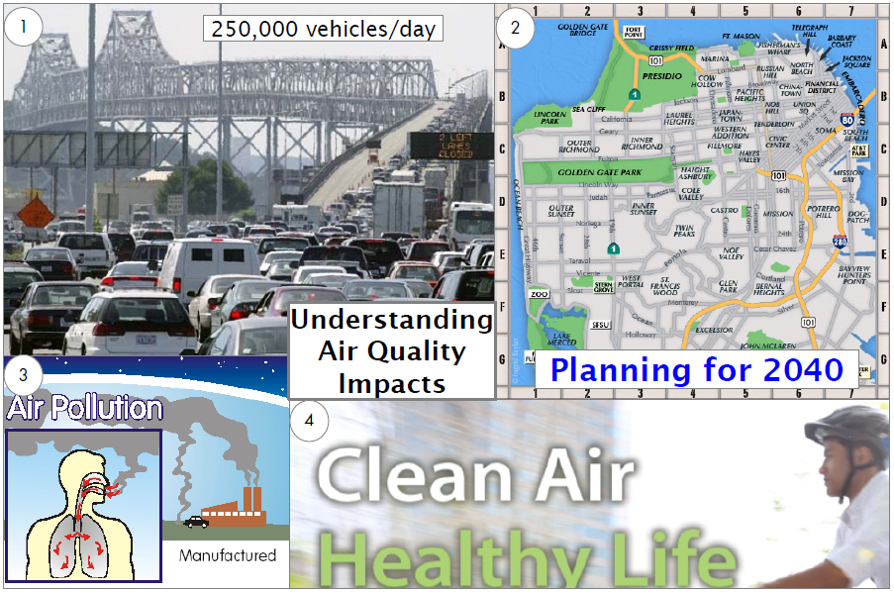
Motivation
Background
Methodology
Tools
Results
Uncertainty
Challenges
Conclusion

Slide 4
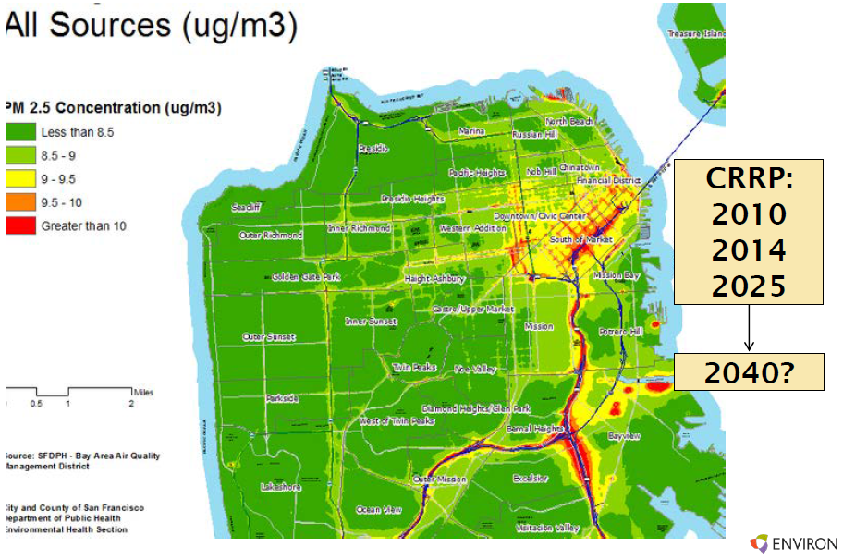

SF Community Risk Reduction Plan
“The objective of the technical work was to identify and map regions of the City of San Francisco where current residents are exposed to higher levels of air pollution and future residents, in new developments, may also be exposed.”
Motivation
Background
Methodology
Tools
Results
Uncertainty
Challenges
Conclusion

Slide 5
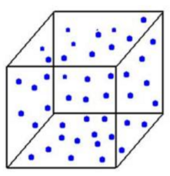
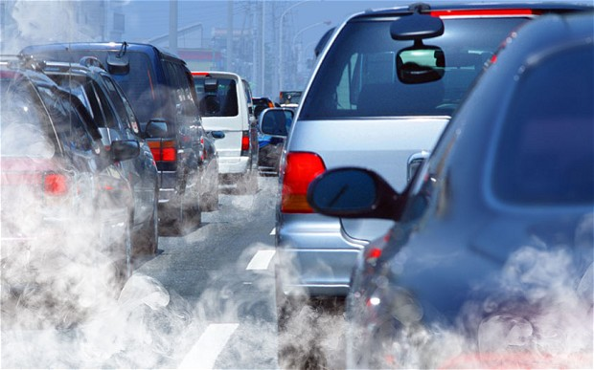
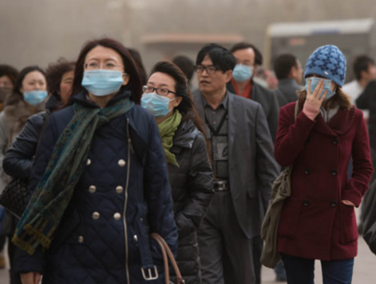

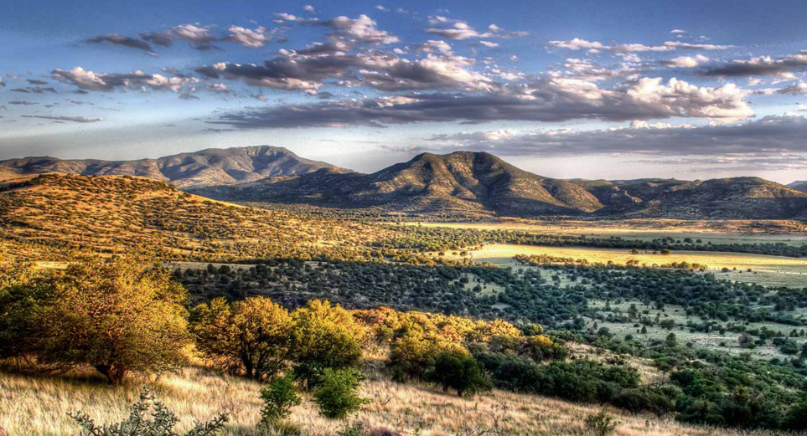
Process for AQ Modeling
Air Quality Model
Input
Output
Input
Input
Input
Pollutant Concentration &
Health Risk Assessment
Emission Estimation
& Source Characteristic
Sensitive Population
Meteorological
Data
Surface Characteristics
Motivation
Background
Methodology
Tools
Results
Uncertainty
Challenges
Conclusion

Slide 6
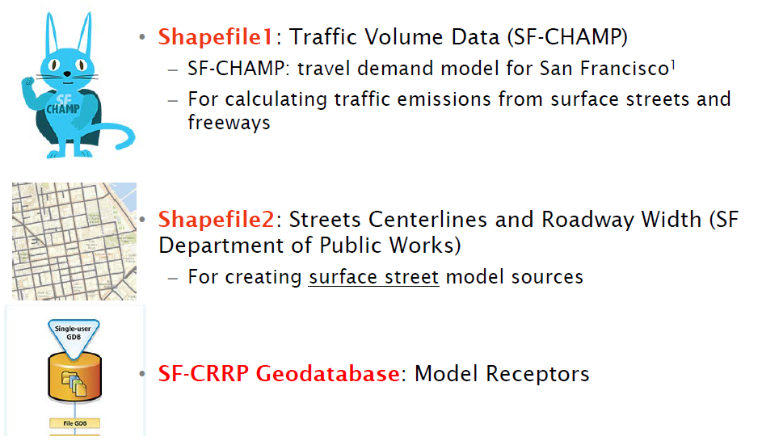
GIS: Data Sources
Motivation
Background
Methodology
Tools
Results
Uncertainty
Challenges
Conclusion

Slide 7
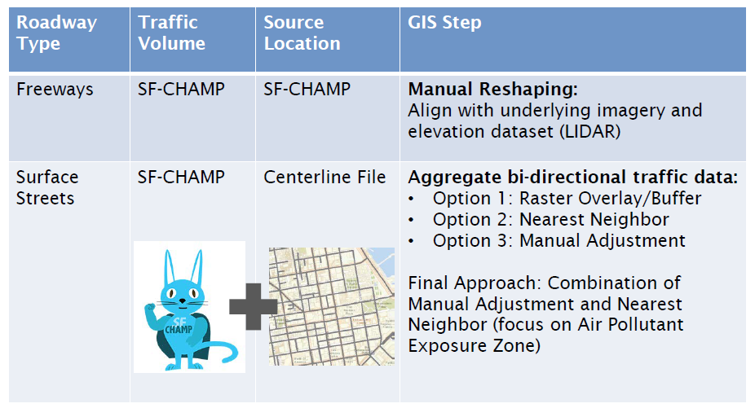
GIS: Traffic Assignment
Motivation
Background
Methodology
Tools
Results
Uncertainty
Challenges
Conclusion

Slide 8
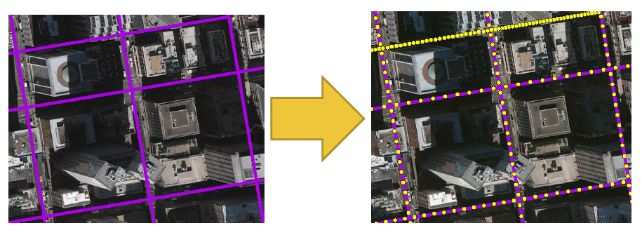
GIS: Traffic Source Setup
Used GIS to create ‘volume sources’ based on Road Segment Length and Width
Motivation
Background
Methodology
Tools
Results
Uncertainty
Challenges
Conclusion

Slide 9
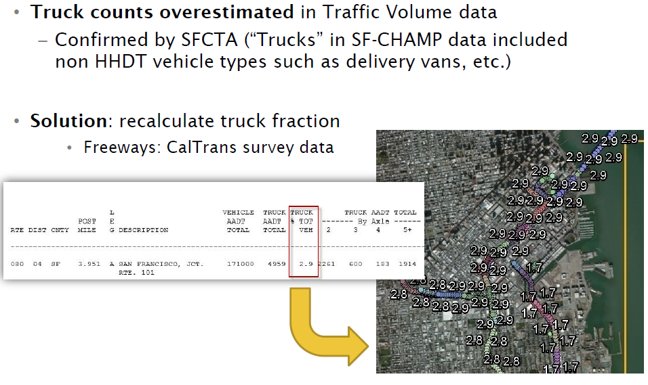
GIS: Truck Fraction for Freeways
Motivation
Background
Methodology
Tools
Results
Uncertainty
Challenges
Conclusion

Slide 10
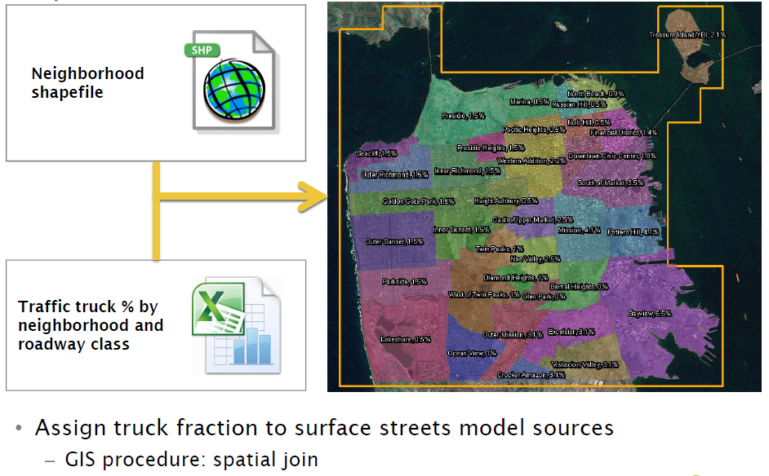
GIS: Truck Fraction for Surface Streets
Motivation
Background
Methodology
Tools
Results
Uncertainty
Challenges
Conclusion

Slide 11

Traffic Emissions
Source | Pollutant | Type
Diesel Vehicles | Diesel Particulate Matter (DPM) | Running Exhaust
 | PM_{2.5} | Running Exhaust & Brake / Tire wear
Gasoline Vehicles | Total Organic Gases (TOG) | Running Exhaust & Running Loss
 | PM_{2.5} | Running Exhaust & Brake / Tire wear
Motivation
Background
Methodology
Tools
Results
Uncertainty
Challenges
Conclusion

Slide 12
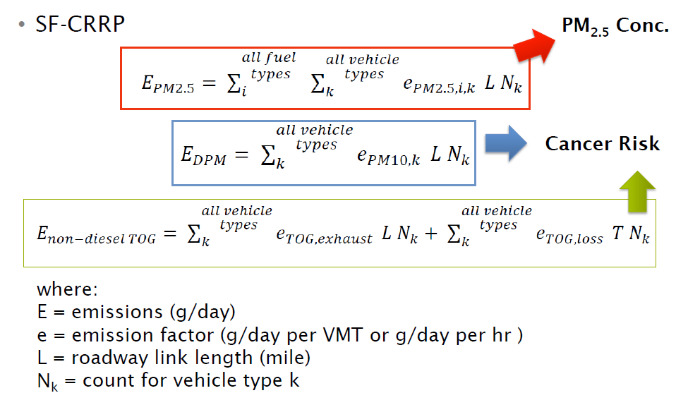
Traffic Emissions
Motivation
Background
Methodology
Tools
Results
Uncertainty
Challenges
Conclusion

Slide 13
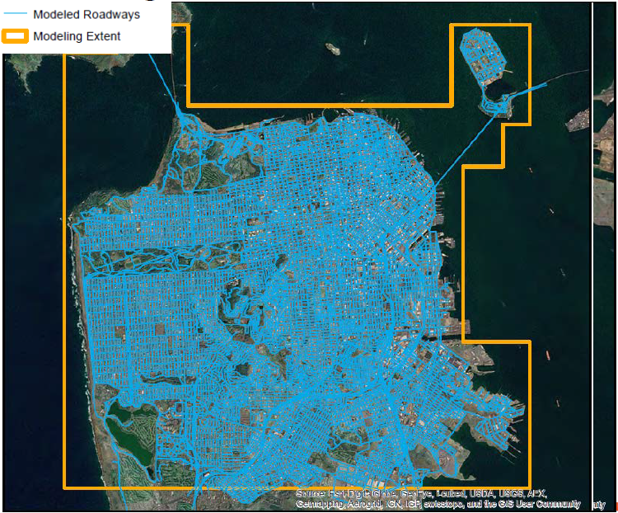
Modeling Extent
Motivation
Background
Methodology
Tools
Results
Uncertainty
Challenges
Conclusion

Slide 14
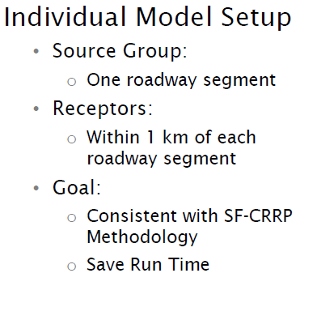
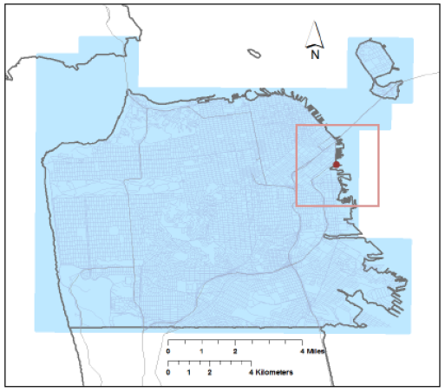
Modeling Approach
Motivation
Background
Methodology
Tools
Results
Uncertainty
Challenges
Conclusion

Slide 15
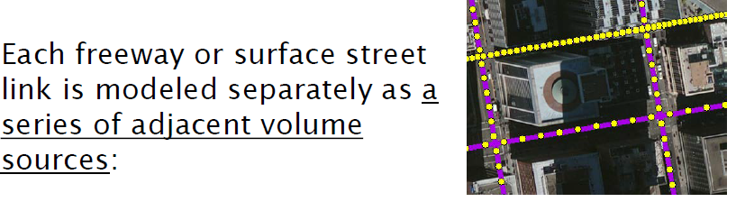
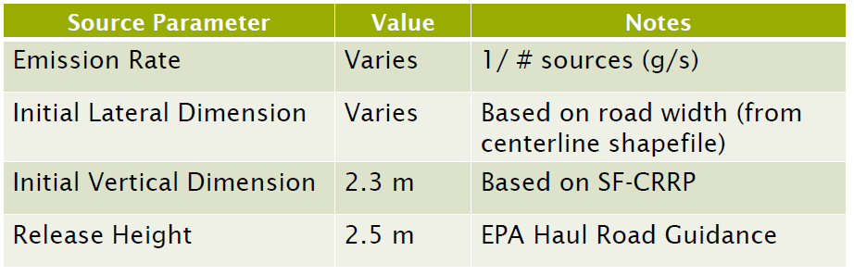
Modeling Extent
Motivation
Background
Methodology
Tools
Results
Uncertainty
Challenges
Conclusion

Slide 16
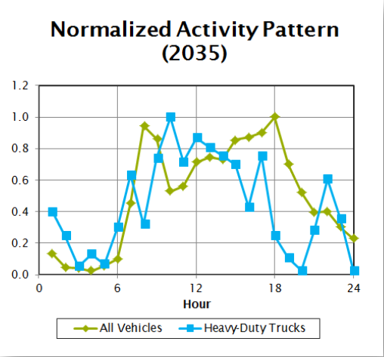
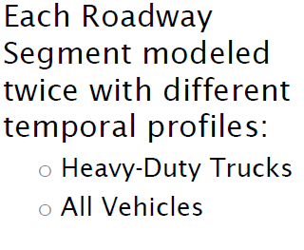
Modeling Extent
Motivation
Background
Methodology
Tools
Results
Uncertainty
Challenges
Conclusion

Slide 17
Modeling Extent
Motivation
Background
Methodology
Tools
Results
Uncertainty
Challenges
Conclusion

Slide 18
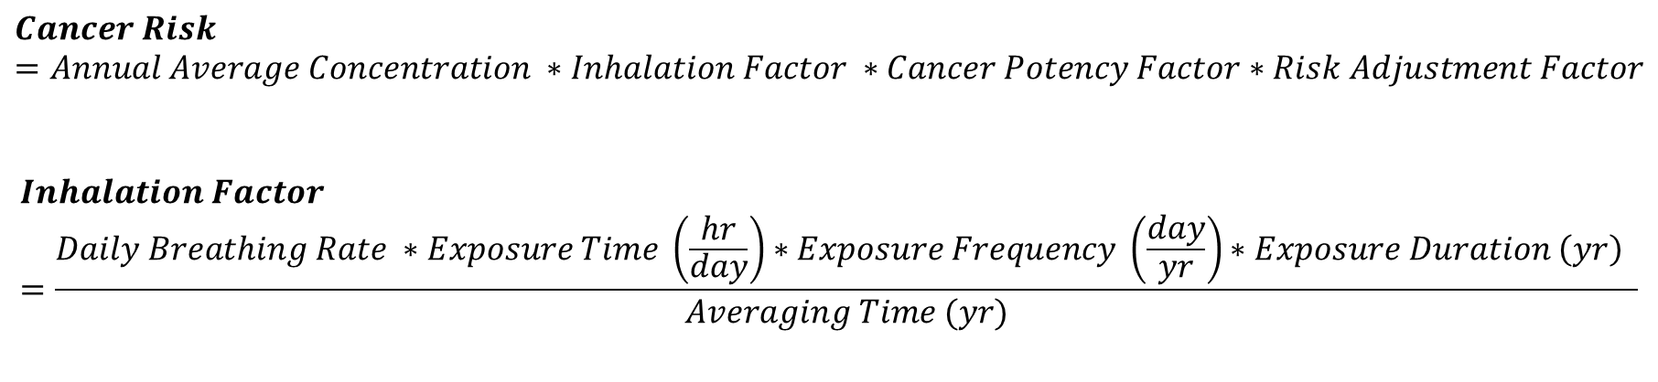
Health Risk Assessment
TOG
1,3 Butadiene
Acetaldehyde
Benzene
Ethylbenzene
Formaldehyde
Naphthalene
Diesel PM
Diesel PM
$$Cancer Risk=Annual Average Concentration ∗Inhalation Factor ∗Cancer Potency Factor∗Risk Adjustment Factor$$
$$Inhalation Factor=\frac{Daily Breathing Rate ∗Exposure Time \left(\frac{hr}{day}\right)∗Exposure Frequency \left(\frac{day}{yr}\right)∗Exposure Duration \left(yr\right) }{Averaging Time (yr)}$$
Motivation
Background
Methodology
Tools
Results
Uncertainty
Challenges
Conclusion

Slide 19
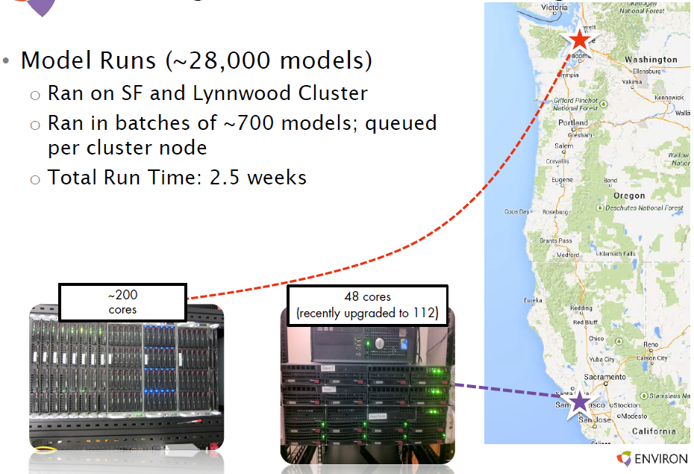
Modeling Challenges
Motivation
Background
Methodology
Tools
Results
Uncertainty
Challenges
Conclusion

Slide 20
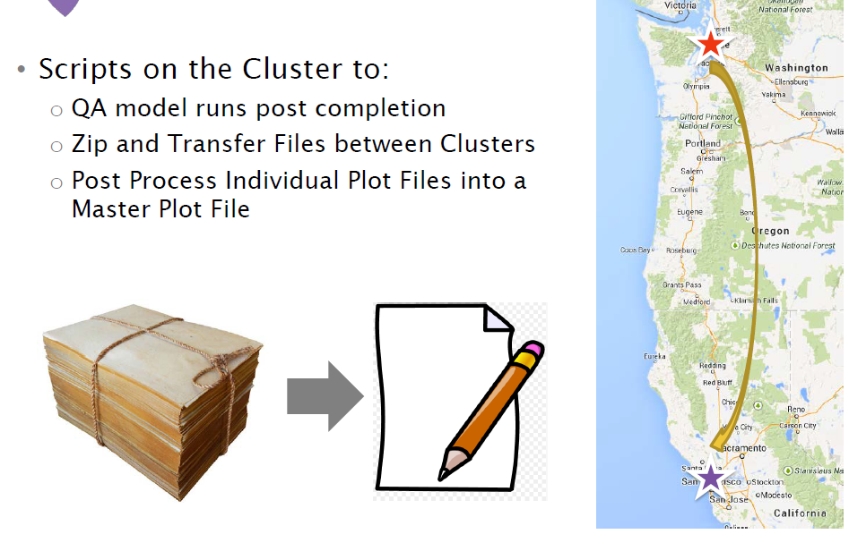


Modeling Challenges
Motivation
Background
Methodology
Tools
Results
Uncertainty
Challenges
Conclusion

Slide 21

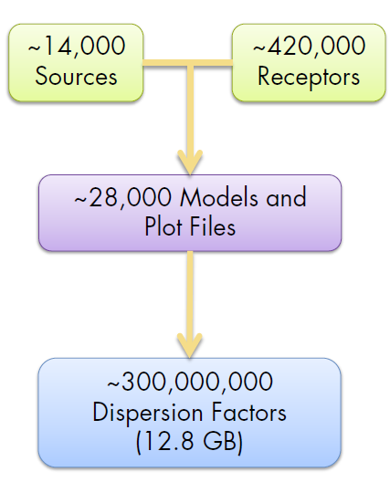
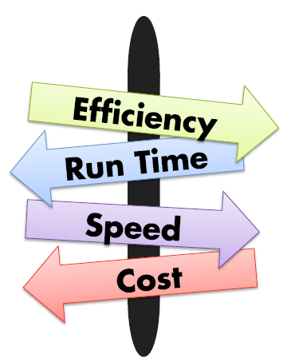
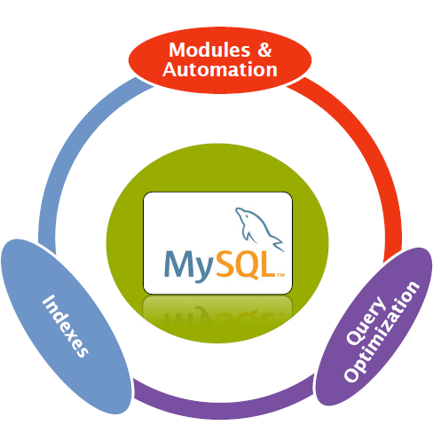
Post Processing Challenges
Motivation
Background
Methodology
Tools
Results
Uncertainty
Challenges
Conclusion

Slide 22
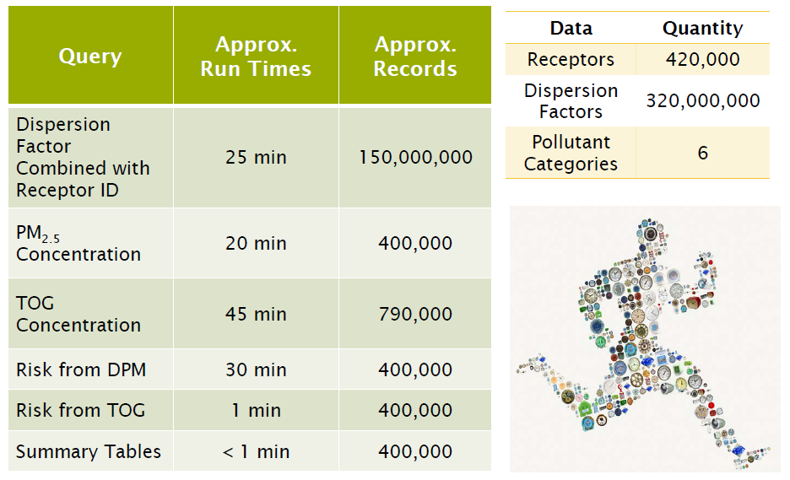
Post Processing Challenges
Motivation
Background
Methodology
Tools
Results
Uncertainty
Challenges
Conclusion

Slide 23
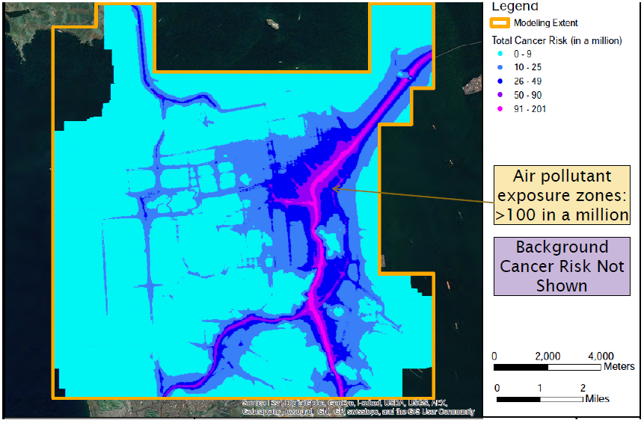
Results: 2040 Traffic Cancer Risk
Motivation
Background
Methodology
Tools
Results
Uncertainty
Challenges
Conclusion

Slide 24
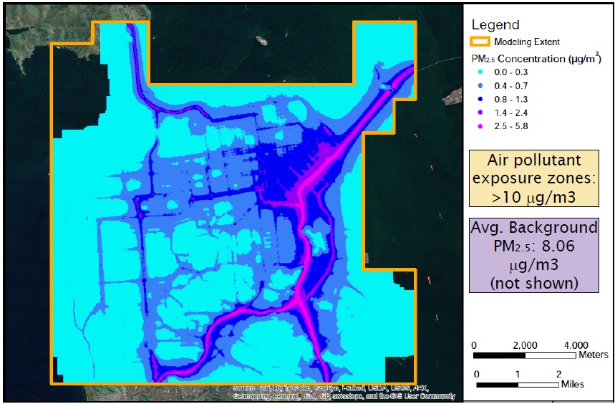
Results: 2040 Traffic PM_{2.5} Concentration
Motivation
Background
Methodology
Tools
Results
Uncertainty
Challenges
Conclusion

Slide 25

Sources of Uncertainty
Source Locations
Source Parameters
Traffic Emissions
Estimation of Exposure Concentrations
Exposure Assumptions
Toxicity Assessment
Risk Calculations
Motivation
Background
Methodology
Tools
Results
Uncertainty
Challenges
Conclusion

Slide 26
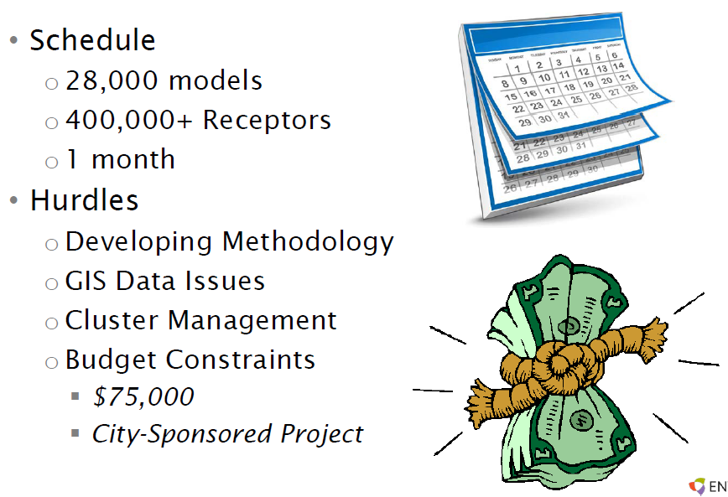
Challenges
Motivation
Background
Methodology
Tools
Results
Uncertainty
Challenges
Conclusion

Slide 27
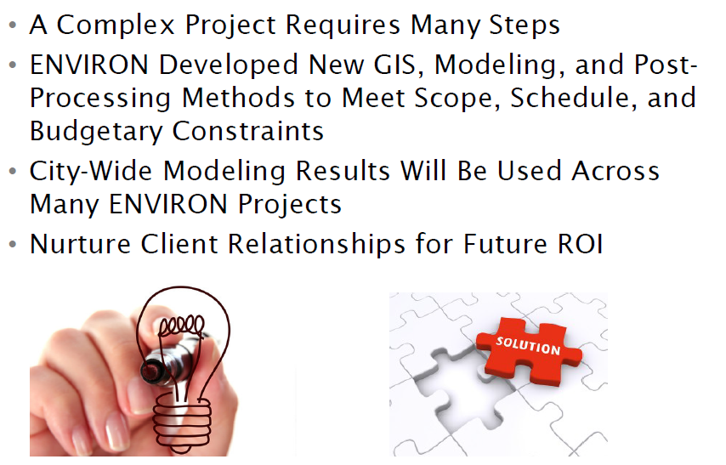
Conclusion
Motivation
Background
Methodology
Tools
Results
Uncertainty
Challenges
Conclusion

